Slide 1
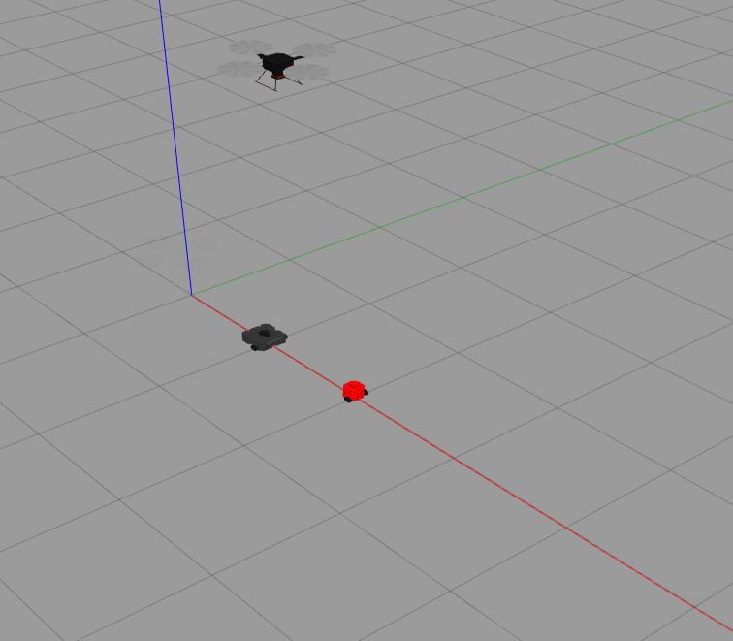

Slide 2









$$Y_{qc cam}$$
$$X_{qc cam}$$
$$Z_{qc cam}$$
$$Z_{w}$$
$$Y_{w}$$
$$X_{w}$$
$$X_{wb cam}$$
$$Z_{wb cam}$$
$$Y_{wb cam}$$

Slide 3


Slide 5



Slide 6















$$A(x_{1},y_{1},z_{1})$$
$$\overset{⃑}{AB}$$
$$\overset{⃑}{AC}$$
$$α$$
$$\overline{AB}$$
$$\overline{AC}$$
$$β$$
$$\overset{⃑}{BA}$$
$$\overset{⃑}{CA}$$
$$γ$$
$$\overset{⃑}{BC}$$
$$B(x_{2},y_{2},z_{2})$$
$$\overline{BC}$$
$$C(x_{3},y_{3},z_{3})$$
$$\overset{⃑}{CB}$$

Slide 7
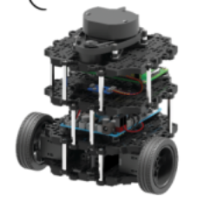













$$v$$
$(p_{x},p_{y}$)
$$O_{c}$$
$$u$$
$$Z_{cam}$$
$(c_{x},c_{y}$)
$$O_{w}$$
$$Z_{w}$$
$$X_{cam}$$
$$X_{w}$$
$$f$$
$$Y_{w}$$
$$Y_{cam}$$

Slide 8
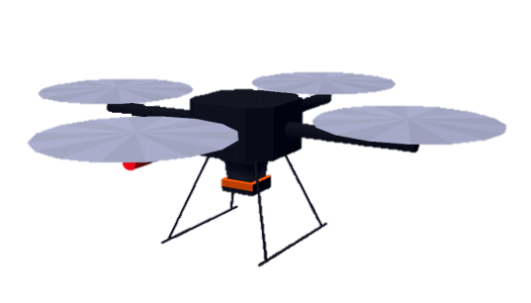
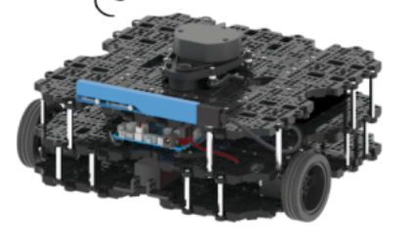

Slide 9
